Slide 1
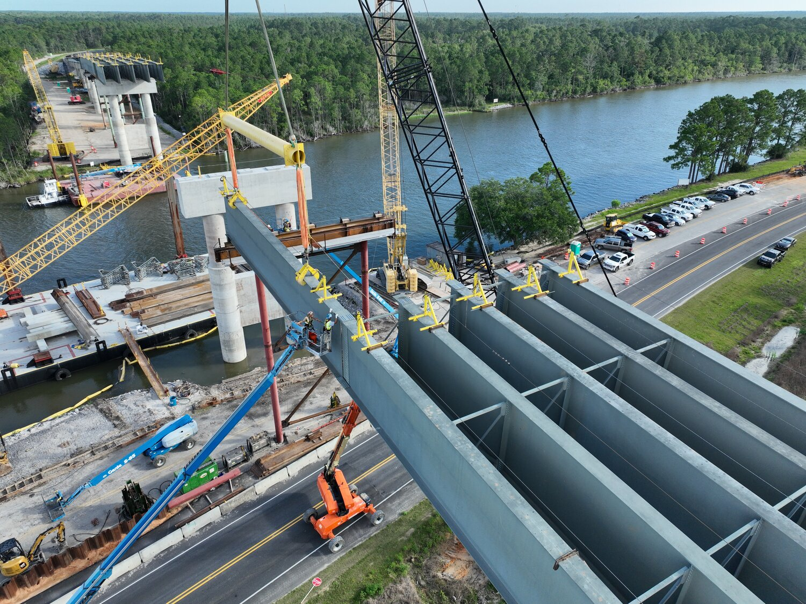

Construction and Materials Management System
RFP Pre-proposal Conference
January 20, 2026

Slide 2
Agenda
10:00 – 10:15am: Introductions
10:15 – 10:30am: Project Overview and Objectives
10:30 – 11:00am: Key Project Dates, Mandatory Minimum Requirements, Scoring
11:00 – 11:30am: Vendor Questions to ALDOT

Slide 3
Introductions
DOT project team and support
Vendors and companies

Slide 4
Project Overview and Objectives
CAMMS provides about 70 percent of ALDOT’s desired functionality for construction management.
The materials and testing functionality currently provides about 40 percent of ALDOT’s desired functionality.

Slide 5
Project Overview and Objectives
Option 1
Full replacement of the existing CAMMS system
Option 2
Develop a solution to supplement and fully build out both the construction and materials and testing functionalities
Vendors may propose one or both of these options

Slide 6
Key Project Dates
Deadline to Submit Questions | 2/6/2026
Official Responses to Questions Posted | 2/13/2026
Proposals Due | 2/27/2026
Evaluation of Proposals | 3/2/2026 – 3/27/2026
Short-listed firm demonstrations and evaluations | 5/4/2026 – 5/22/2026
Anticipated Notice of Selection | 6/1/2026 – 6/5/2026

Slide 7
Mandatory Minimum Requirements
Commercially available software application.
Successful implementation for two (2) public agencies with similar size and scope as ALDOT.
Reference letters from the two public agencies noted above.
SaaS pricing for a total of ten (10) years from date of project initiation.

Slide 8
Mandatory Minimums
Mobile component that can be used by field staff at a minimum for Apple iOS and Android platforms.
Bidirectional integration with ALDOT GIS data from both ALDOT and external sources along with other existing business systems as needed.
Integration with existing CAMMS data.
Include the level of effort that will be required by ALDOT staff for implementation.

Slide 9
Scoring: Phase 1
Phase 1: Detailed Technical Response (1000 Total Points Possible)
EVALUATION CRITERIA | Points Possible
1. Understanding and Experience (150 points)
Clear grasp of ALDOT construction and materials management, and best practices | 100
Demonstrated experience with DOTs or similar public agencies | 25
Reference letters from a minimum of two projects | 25
2. Team Structure and Personnel (125 points)
Roles and credentials of key personnel on project team | 75
Recent successes on similarly scoped project experiences | 50
3. Firm's Implementation Capability (225 points)
Implementation approach | 100
Project and change management approach | 75
QA/QC and Testing plan | 50
4. Solution's Capability (500 points)
Ability to meet mandatory requirements out of the box or with configuration | 300
Ability to interact/interface with ALDOT key systems | 125
Querying and reporting capabilities | 75

Slide 10
Scoring: Phase 2
Phase 2: Short-Listed Vendor Demonstration and Cost (1000 Total Points Possible)
EVALUATION CRITERIA | Points Possible
1. Short-Listed Vendor Demonstration (800 points) | 800
2. Cost (200 points) | 200
Cost Formula:
Proposer A’s Price Points = Lowest Proposed Price/Proposer A Price * 200
Example:
Lowest Price = $1,000,000
Proposer A Price = $1,500,000
Proposer A receives 1,000,000/1,500,000 * 200 = 133 points

Slide 11
Vendor Questions to ALDOT
?

